Slide 1


STATISTIC REPORT

Slide 2
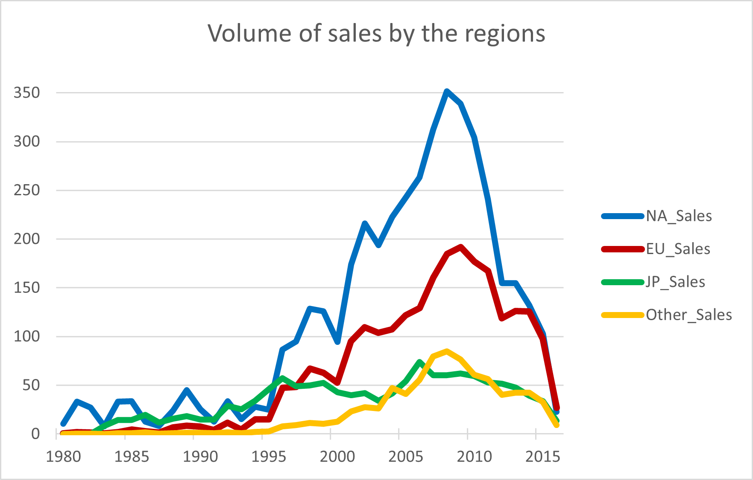
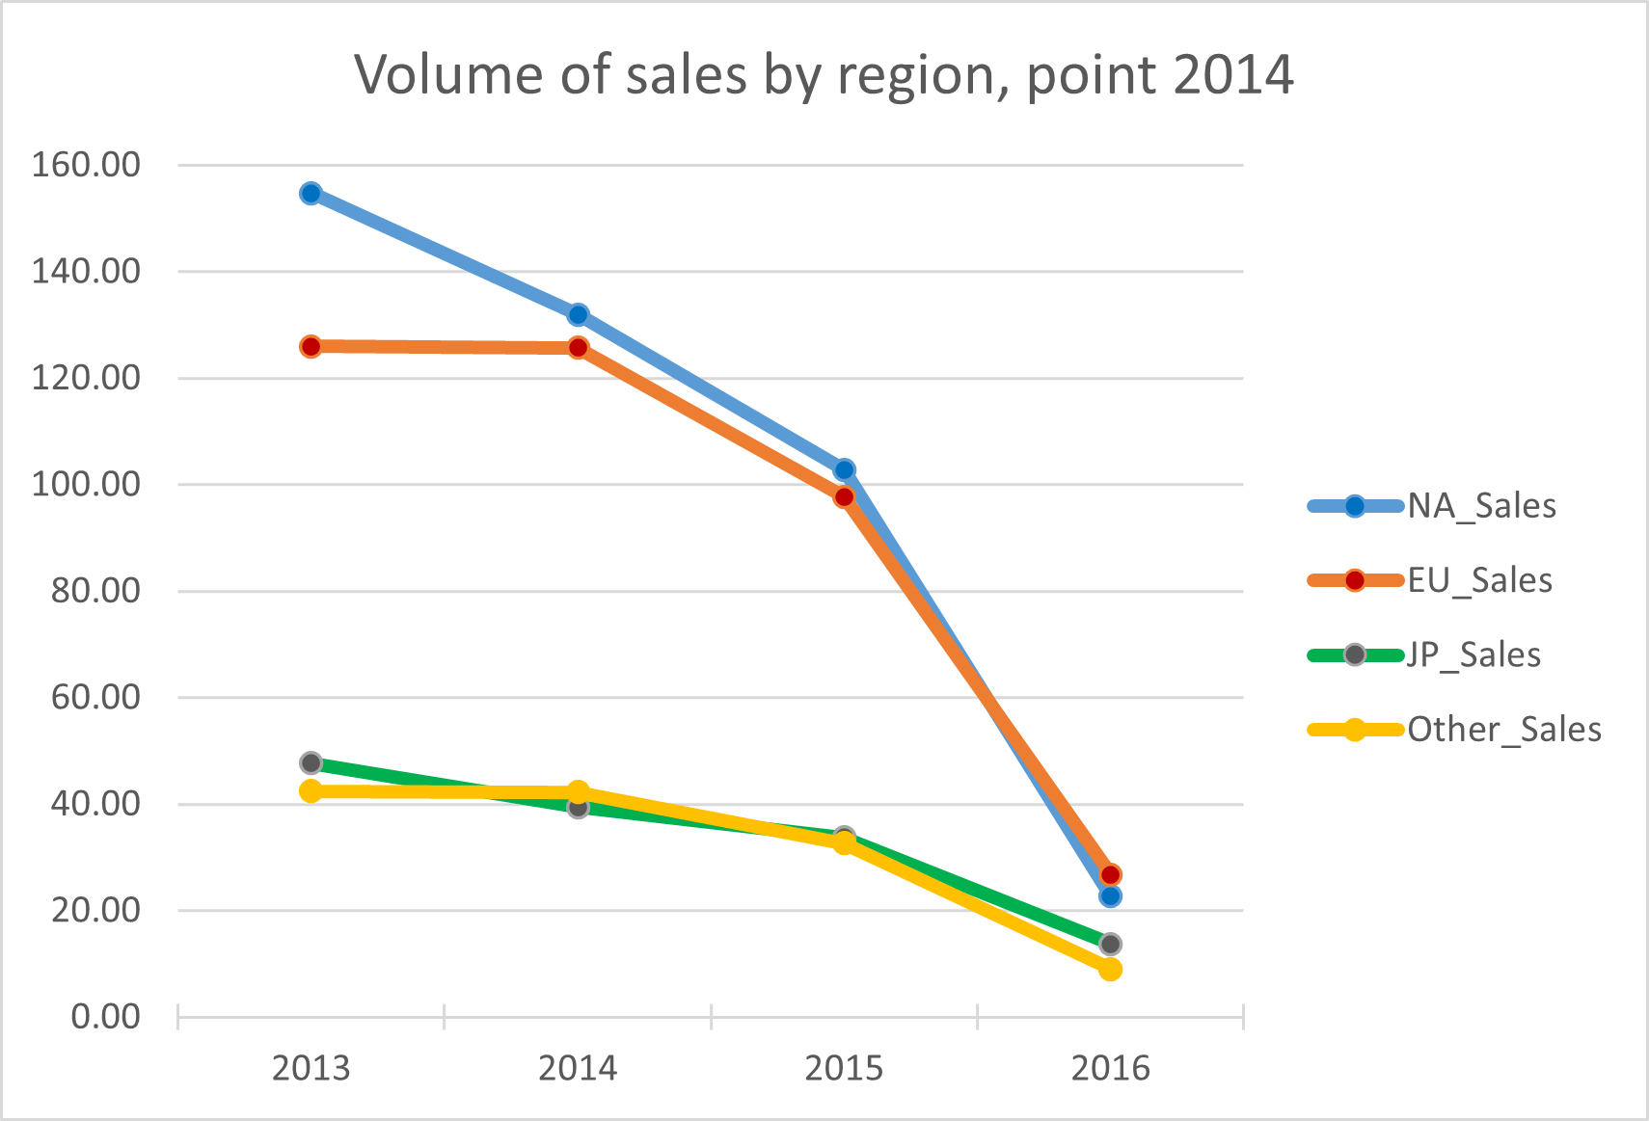
Figure 1,1: Sales by region and by the year 1981-2015 (in hundred of pieces)
Dynamics of region sales in the past
Game Co has been successfully selling video games in various regions for many years. The volume of sales from 1981 to 2015 is represented in Figure 1.1
As we can see the data does not confirm the assumption that sales for the various geographic regions have stayed the same over time. Opposite the data shows different dynamics.
The sales grew in the EU and Other regions between 1996 and 2009 (from 1,1M to 66,8M in Global sales), the sales decreased in all regions between 2009 to 2015 (from 66.8M to 26,4 in Global sales) and there was stabilization in the EU and Others in 2014 only (on the level of33,8M of Global sales).
Therefore to understand how it goes now, we will use data from 2014 as a reference for comparison.
The sales data for the current year is not complete but it is included in the analysis to present the actual state.
Figure 1.2: Point of reference by comparison (sales in hundred of pieces)

Slide 3
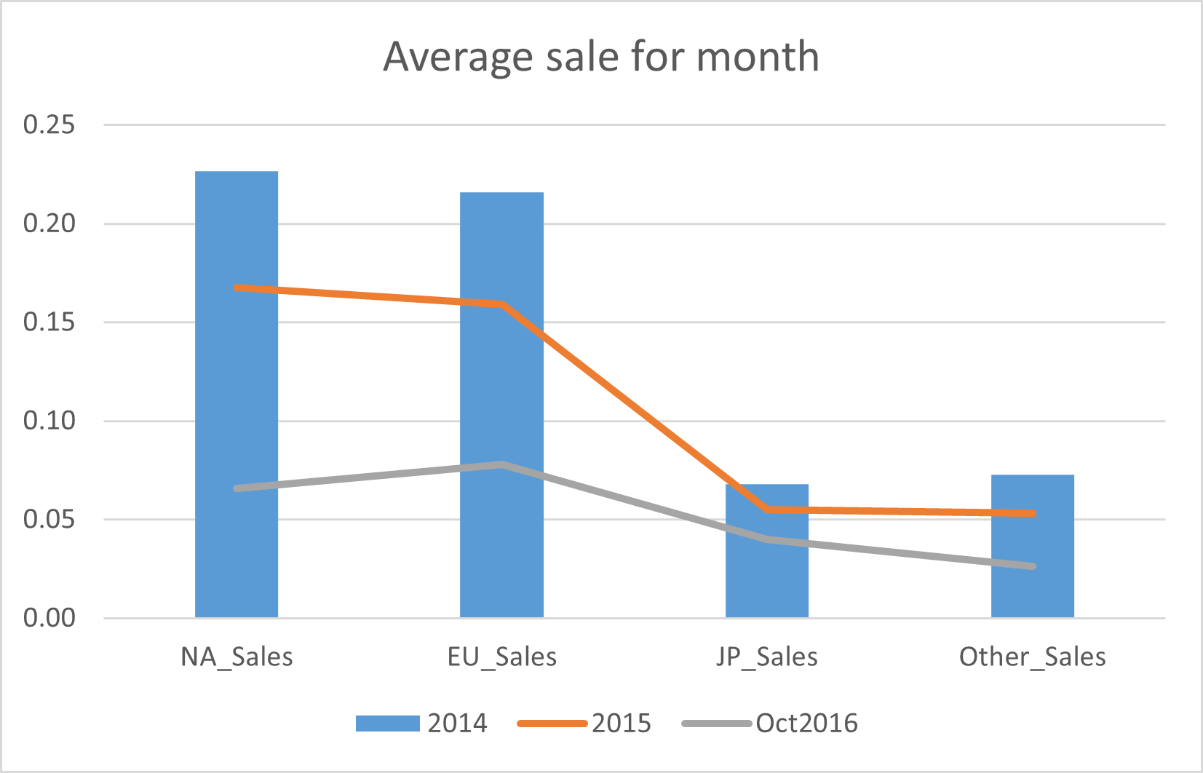
Figure 2: Average for monthly sales by regions (in hundred of pieces)
The actual state of sales (October 2016)
Was the stabilization of 2014 fixed or was the sales level of 2015 fixed at least? That is the question. Figure 2 represents sales for the month by the region where the blue columns are region sales of 2014:
(23000 pieces/month for NA, 22000 pieces/month for EU, and 7000 pieces/month for each of JP and Others), the red line is the level of 2015:
(17000 pieces/month for NA, 16000 pieces/month for EU, and 5000 pieces/month for each of JP and Others), and the gray one is for the level of the current year:
(7000 pieces/month for NA, 8000 pieces/month for EU, 4000 pieces/month for JP, and 3000 pieces/month for Others). Even though there are 3 months of 2016 including a Christmas period to complete, seems that only JP could reach the level of 2015.
But if the structure of sales is good, then Game Co. most likely can restore the sales volume in the next year.

Slide 4
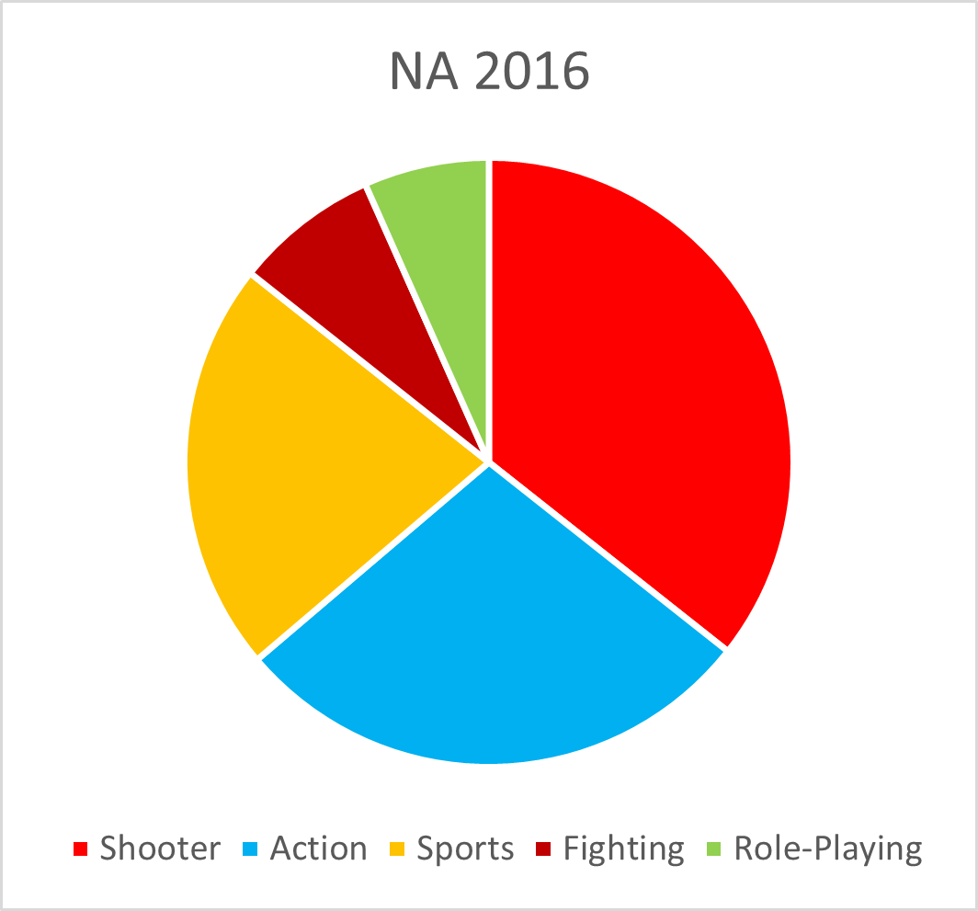
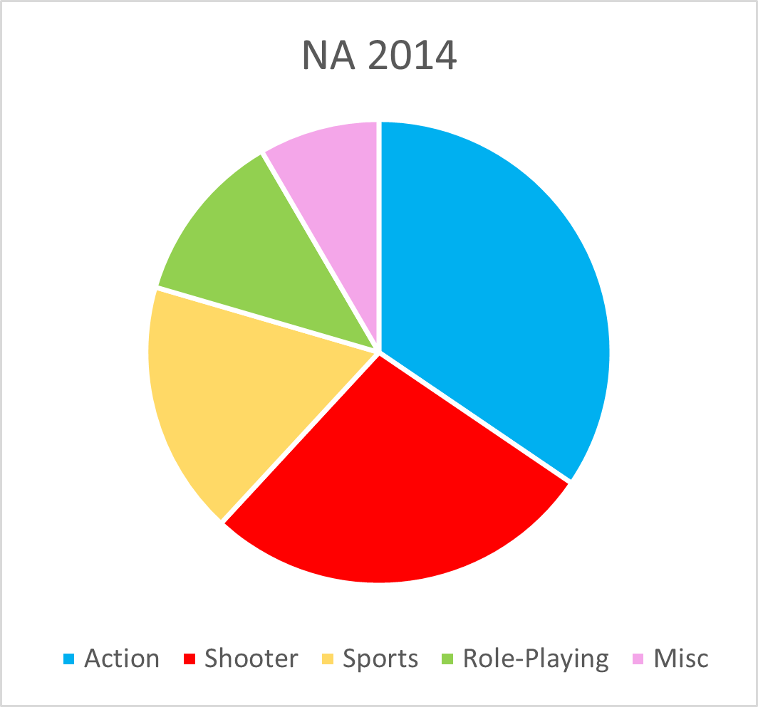
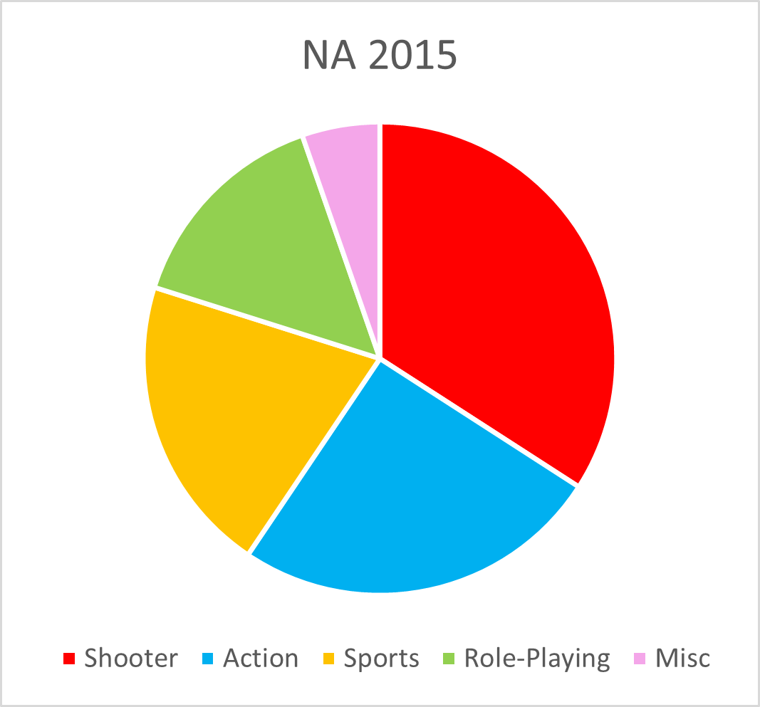
What is to look at in the sales structure in NA?
Figure 3.3: Composition of
NA sales in 2016 (top 5 genres)
The NA region is the leading region of game sales in the World. This region is also leading in Global sales of Game Co over the years.
For the last years, the NA sales volume has decreased in all genres, while the sales structure by genre looks good except for Role-Playing games which part in NA sales is only half of the last year’s level:
2014 – 2015 – Oct 2016
Shooter: 23,3% – 22,2%- 25.9%
Action: 29,3% - 22,2% - 25,9%
Sport : 15,0% - 18,0% - 22,0%
Role-Playing : 10,3% - 13,0% - 6,1%
Based on this data we have a good chance to recover sales volume in the future.
Marketing support for sales of Role-Playing games is recommended
Figure 3.1: Composition of
NA sales in 2014 (top 5 genres)
Figure 3.2: Composition of
NA sales in 2015 (top 5 genres)

Slide 5
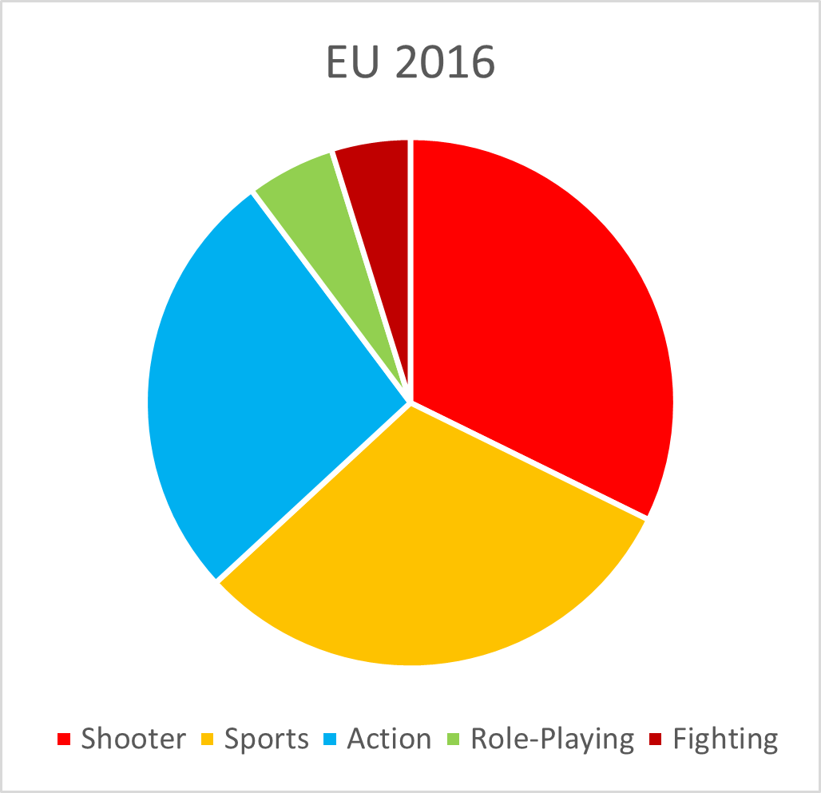
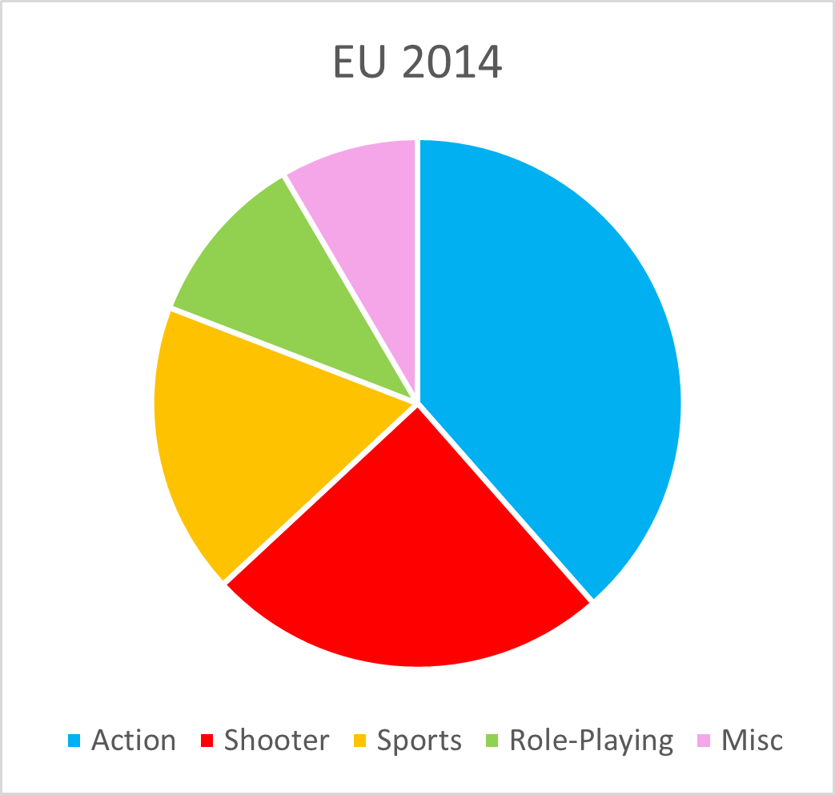
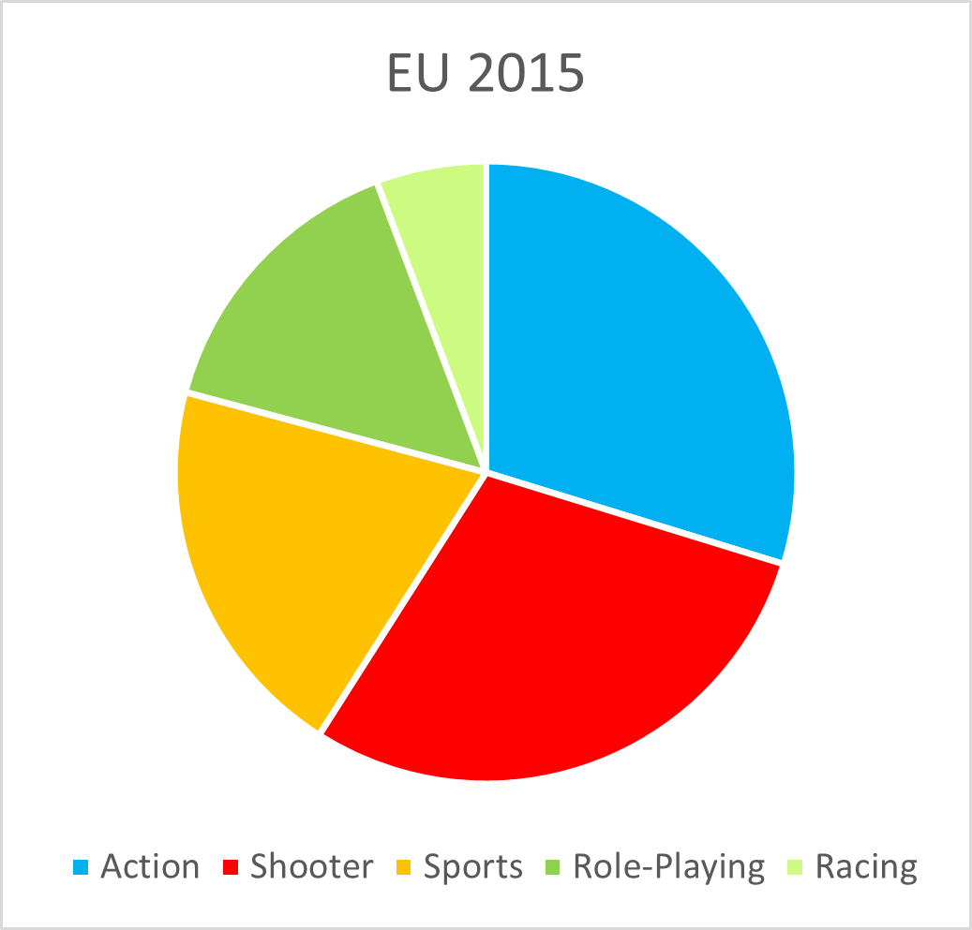
What is to look for in sales structure in the EU?
Figure 4.3: Composition of
EU sales in 2016 (top 5 genres)
The EU region is the second most relevant region of gaming in the World and the second most important region in Game Co sales.
The sales structure by genre shows a decrease in the Action and Role-Playing genres by almost half.
2014 – 2015 - 2016
Shooter: 20,5% – 24,8%- 28.2%
Action: 32,2% - 25,3% - 23,7%
Sport : 18,7% - 16,7% - 27,5%
Role-Playing : 9,0% - 13,8% - 4,8%
Marketing support for sales of Role-Playing and Action games is recommended.
Figure 4.1: Composition of
EU sales in 2014 (top 5 genres)
Figure 4.2: Composition of
EU sales in 2015 (top 5 genres)

Slide 6
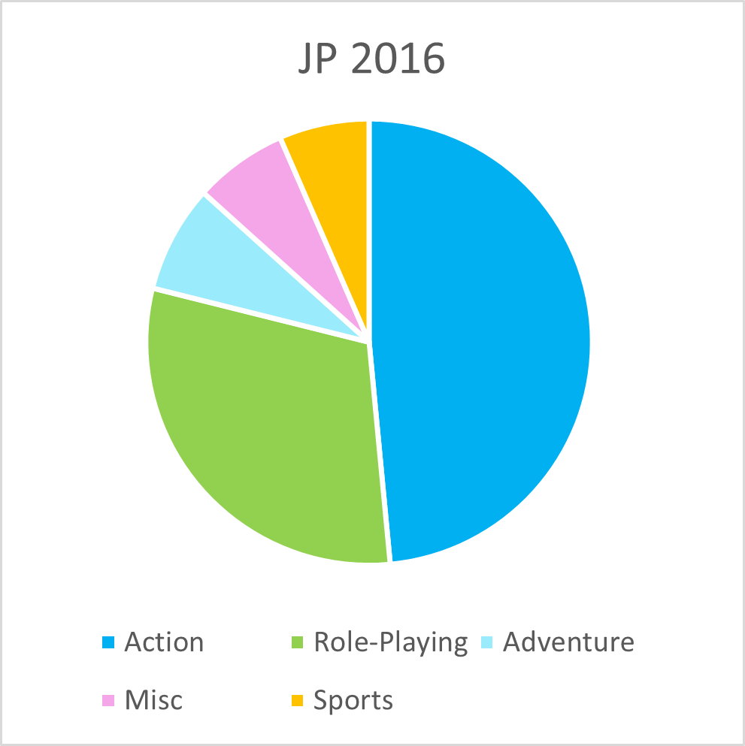
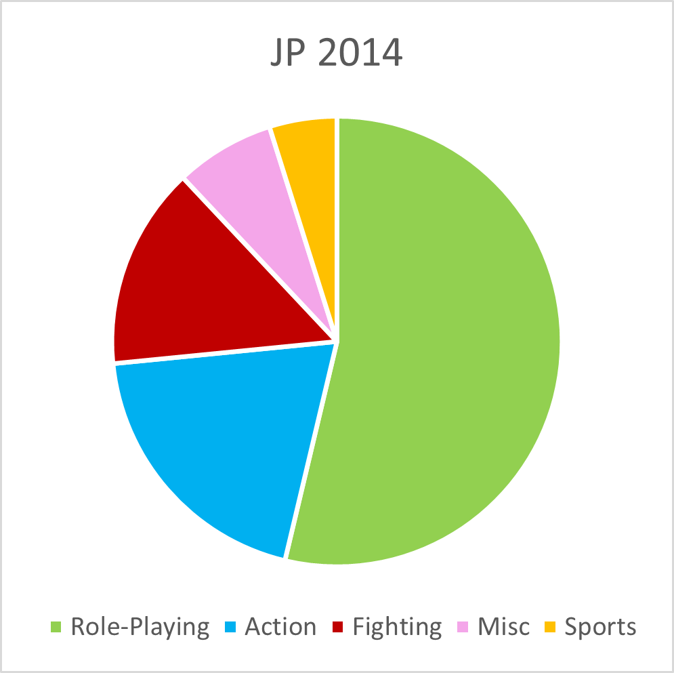
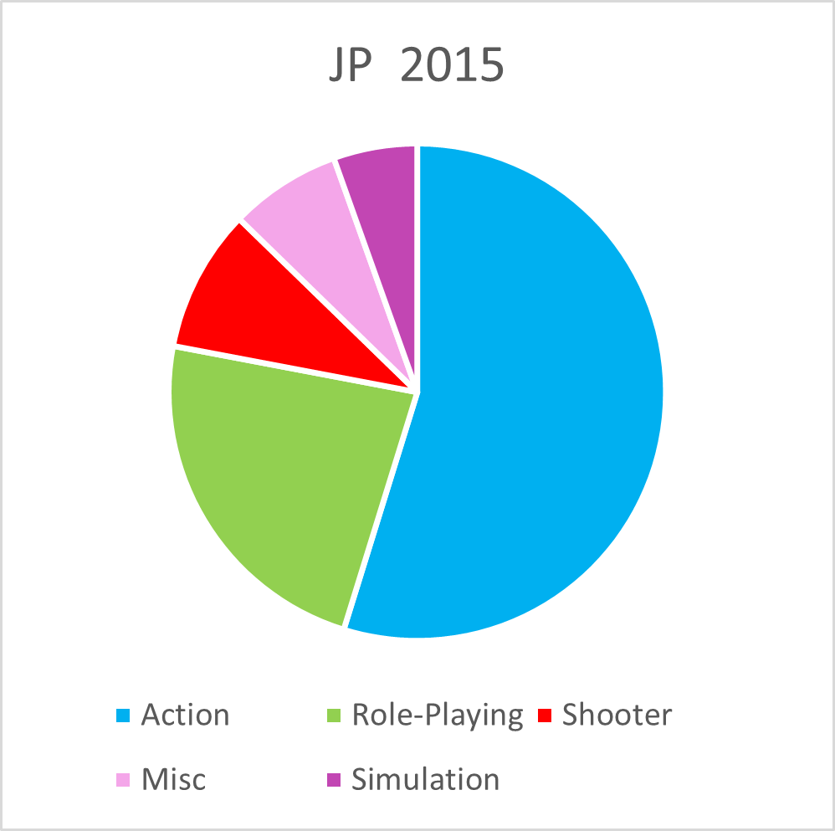
What is to look for in the sales structure in Japan?
Figure 5.3: Composition of
JP sales in 2016 (top 5 genres)
The Japan region is the third most relevant region of gaming in the World and it is one of the most important regions in Game Co sales.
Role-playing games are the leading genre in Japan market, but there is a decrease in our sales by 45%. See Figure 5.
2014 – 2015 - 2016
Role-playing: 44,9% – 20,0% - 26.5%
Action: 16,5% - 47,0% - 42,3%
Fighting : 12,2,% - 2,4% - 4,7%
Special marketing and management support for Role-Playing and Fighting games are highly recommended.
Figure 5.1: Composition of
JP sales in 2014 (top 5 genres)
Figure 5.2: Composition of
JP sales in 2015 (top 5 genres)

Slide 7
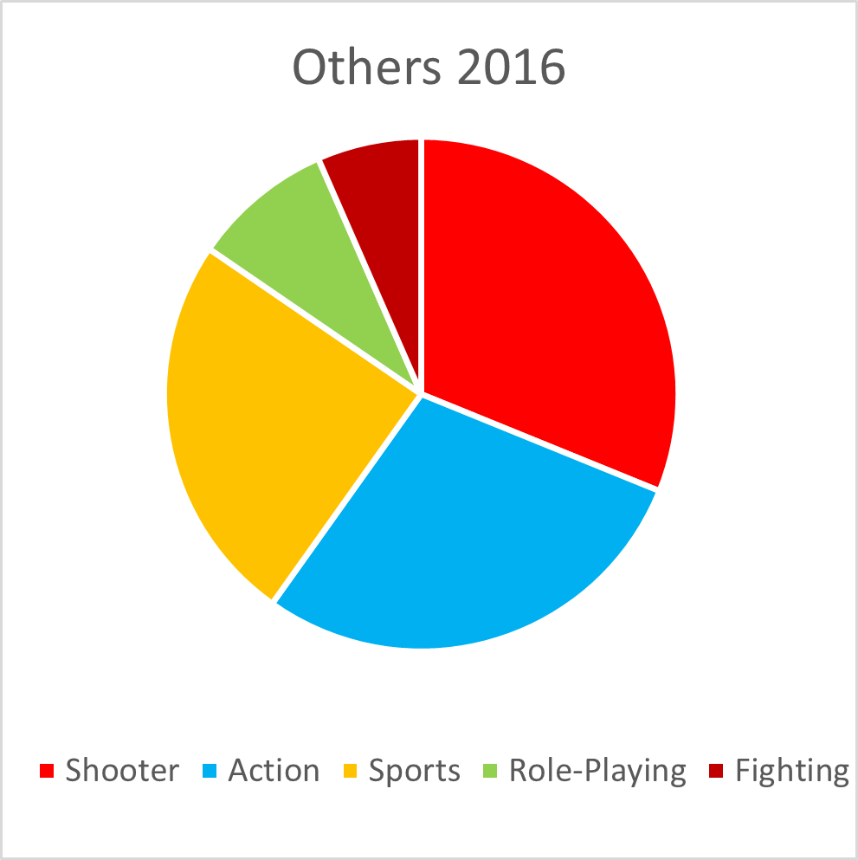
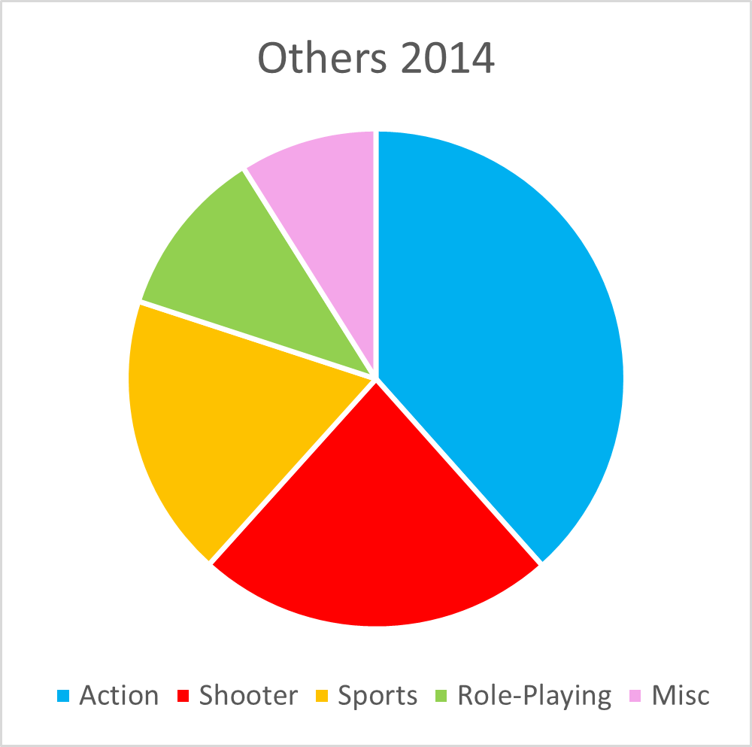
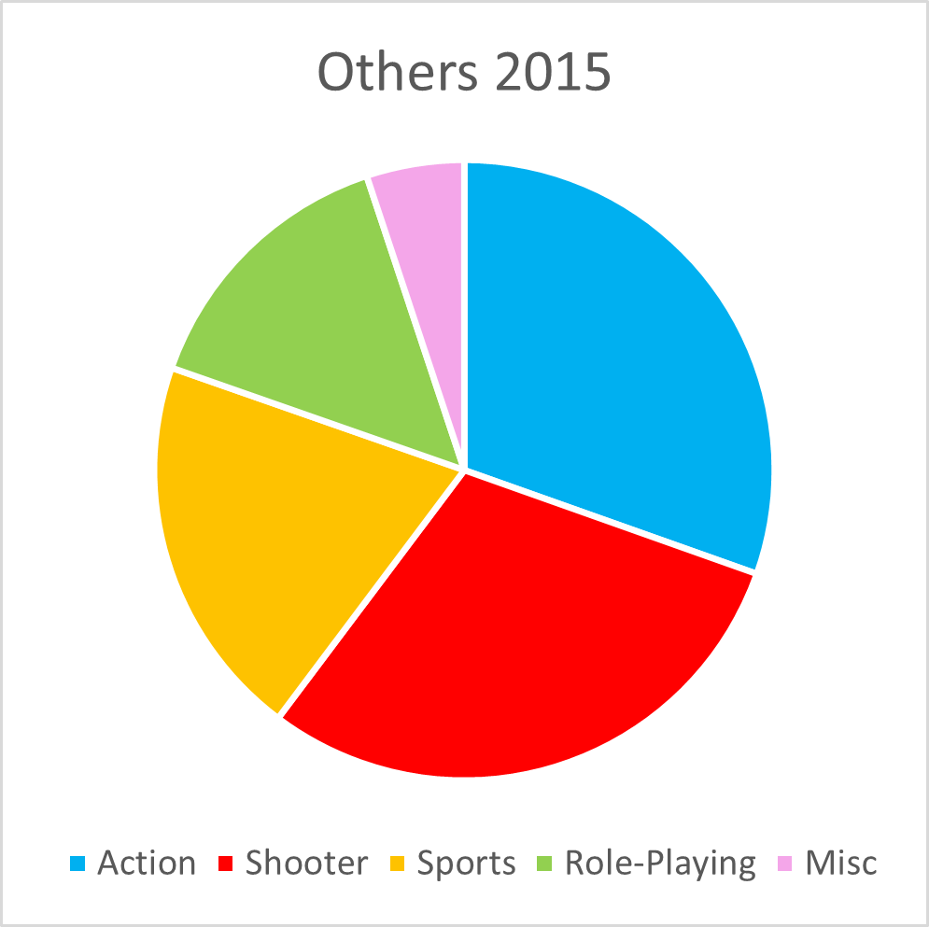
What is to look for in the sales structure in Other regions?
Figure 6.3: Composition of
Other region’s sales in 2016 (top 5 genres)
The Other region is the united data of some non-specified regions whose summarized sales volume is about 10% of Global sales.
The role-playing genre is one of the leading genres in Other regions, but there is actually a decrease from 12,6% to 7.7% (see Figure 6.2)
Music games decreased 2 consecutive years for 42%
2014 – 2015 - 2016
Role-playing: 9,4% – 12,6% - 7.7%
Action: 32,8% - 26,3% - 24,9%
Music : 7,6,% - 4,4% - 2,5%
Special marketing and management support for Music games is highly recommended.
Figure 6.1: Composition of
Other region’s sales in 2014 (top 5 genres)
Figure 6.2: Composition of
Other region’s sales in 2015 (top 5 genres)

Slide 8
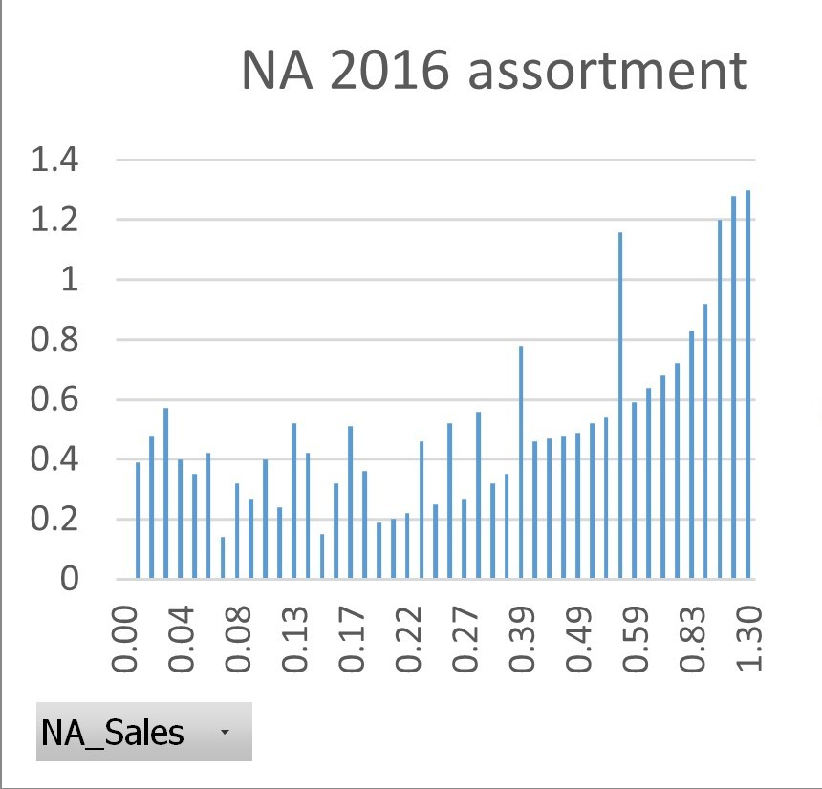
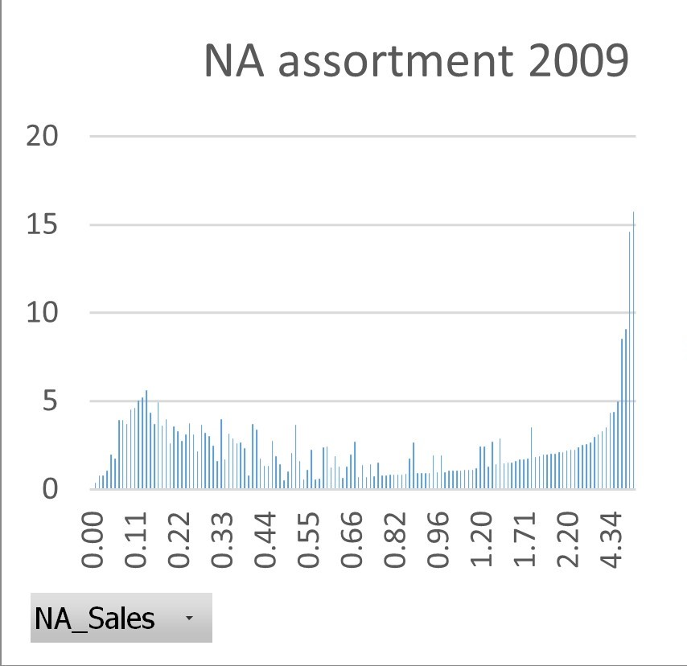
What is to look at in the product Assortment?
Figure 7.1: The Assortment of NA Sales 2016 (in hundred pieces for popularity range)
By “assortment” we mean games ranged by popularity (x) according to their sales volume (y).
More well-selling games we will have in our assortment-higher the volume of sales we will have.
What changed specifically in assortment by each region? We compare the data of the year when the sales increased the last time and the current year (2016).
The NA region:
The sales volume of the most popular games decreased
from 15 to 1,2 hundred pieces
The highest popularity range of games decreased
from 4,34 to 1,30.
The game assortment revision is recommended
Figure 7.2: The Assortment of NA Sales 2009
(in hundred pieces for popularity range)

Slide 9
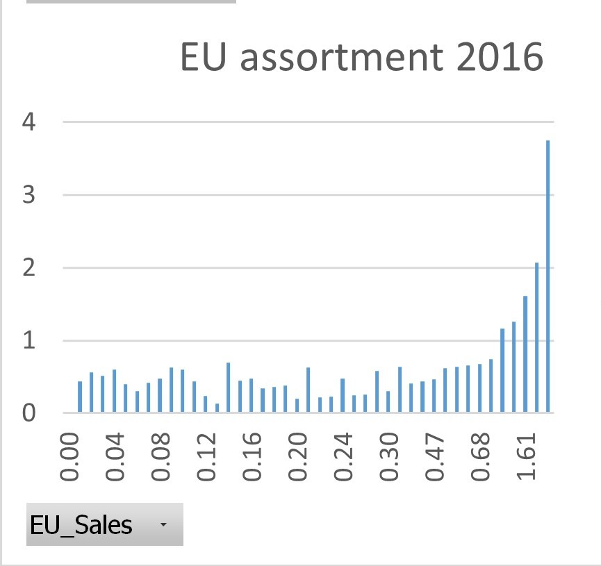
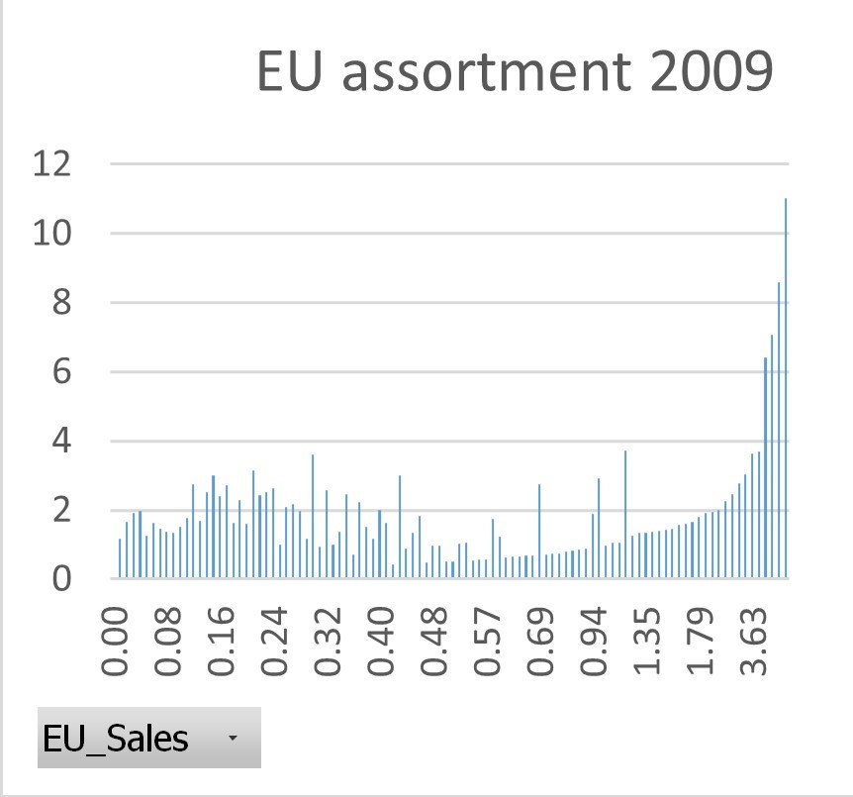
What is to look at in the product Assortment?
Figure 8.1: The Assortment EU 2016(in hundred pieces for popularity range)
The EU region:
The sales volume of most popular games decreased
from 11 to 3,8 hundred pieces.
The maximal popularity range of games decreased
from 3,63 to 1,61.
The game assortment revision is recommended
Figure 8.2: The Assortment EU 2009 (in hundred pieces for popularity range)

Slide 10
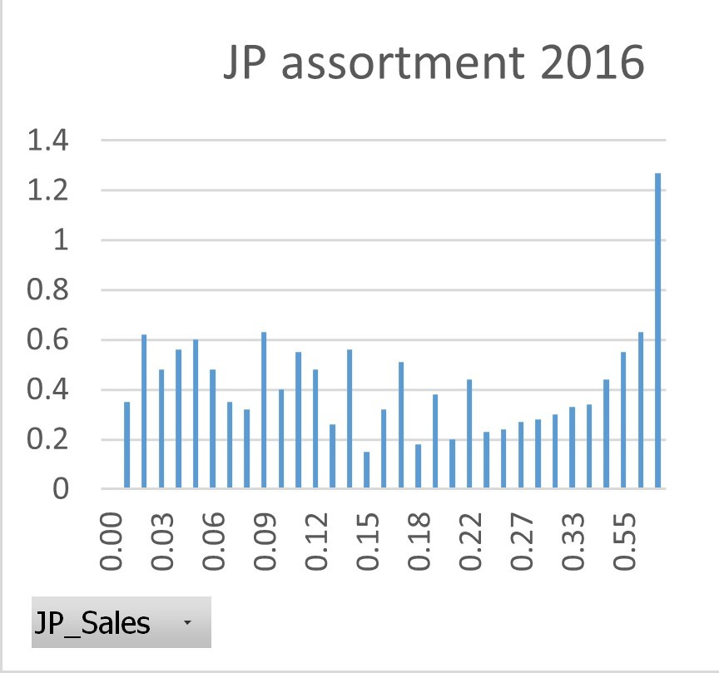
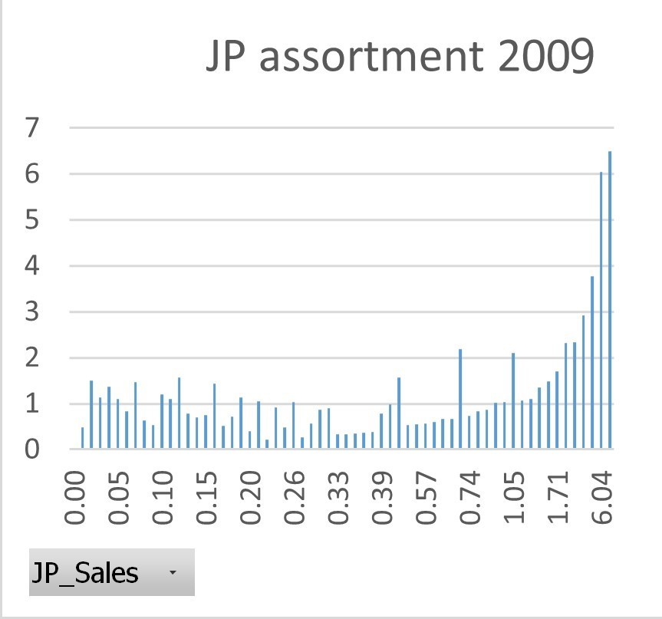
What is to look at in the Assortment?
Figure 9.1: The Assortment of JP Sales 2016(in hundred pieces for popularity range)
The JP region:
The sales volume of most popular games decreased
from 6,5 to 1,3 hundred pieces.
The maximal popularity range of games is decreased
from 6,04 to 0,55.
The game assortment revision is recommended
Figure 9.2: The Assortment of JP Sales 2009 (in hundred pieces for popularity range)

Slide 11
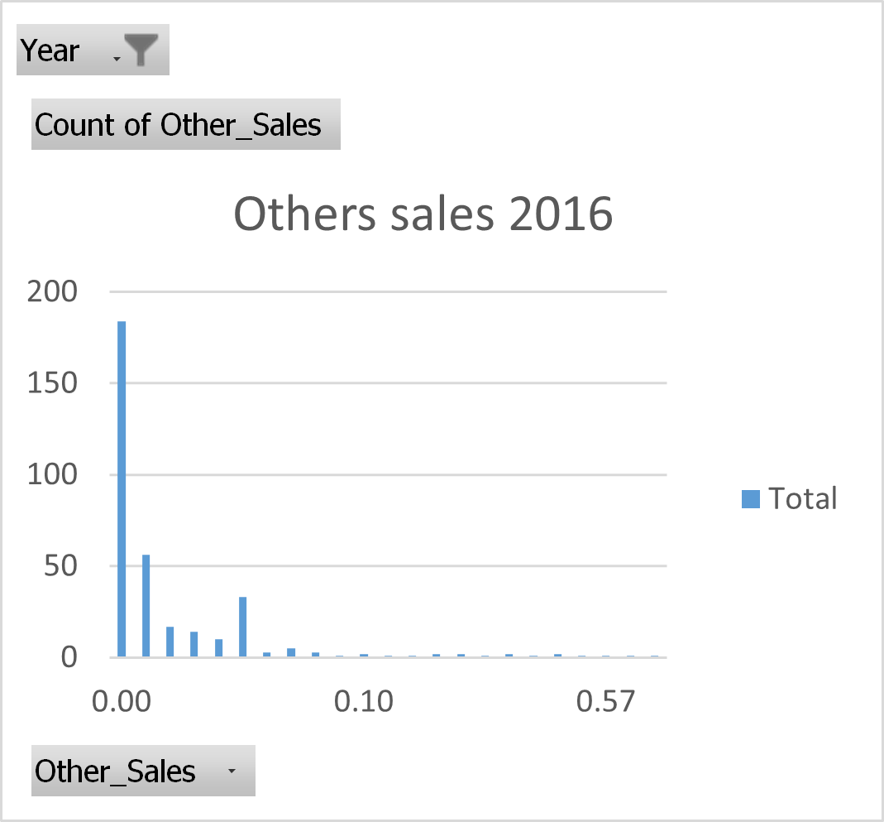
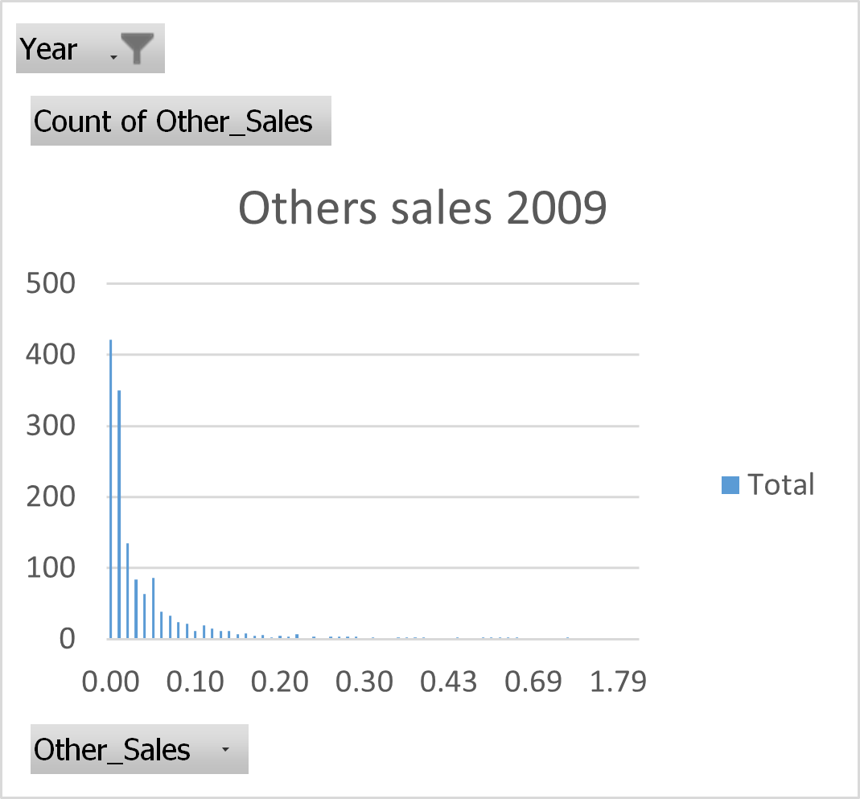
What is to look at in the Assortment?
Figure 10.1: The Assortment of Other Sales 2016 (in hundred pieces for popularity range)
The Others region:
Sales are concentrated in the area of small quantity sales.
The sales volume of most popular games is decreased
from 421 to 184 hundred pieces.
The maximal popularity range of games is decreased
from 0,02 to 0,10.
The sales strategy revision is recommended
The game assortment revision is recommended
Figure 10.2: The Assortment of Other Sales 2009 (in hundred pieces for popularity range)

Slide 12
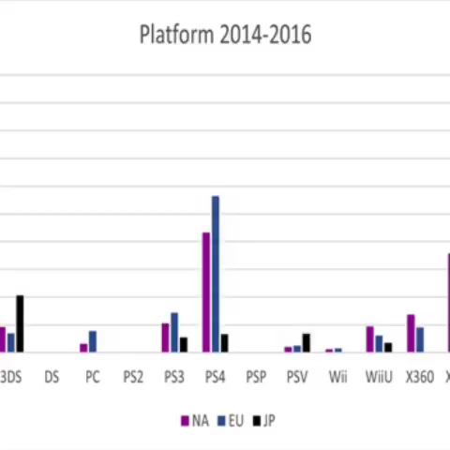
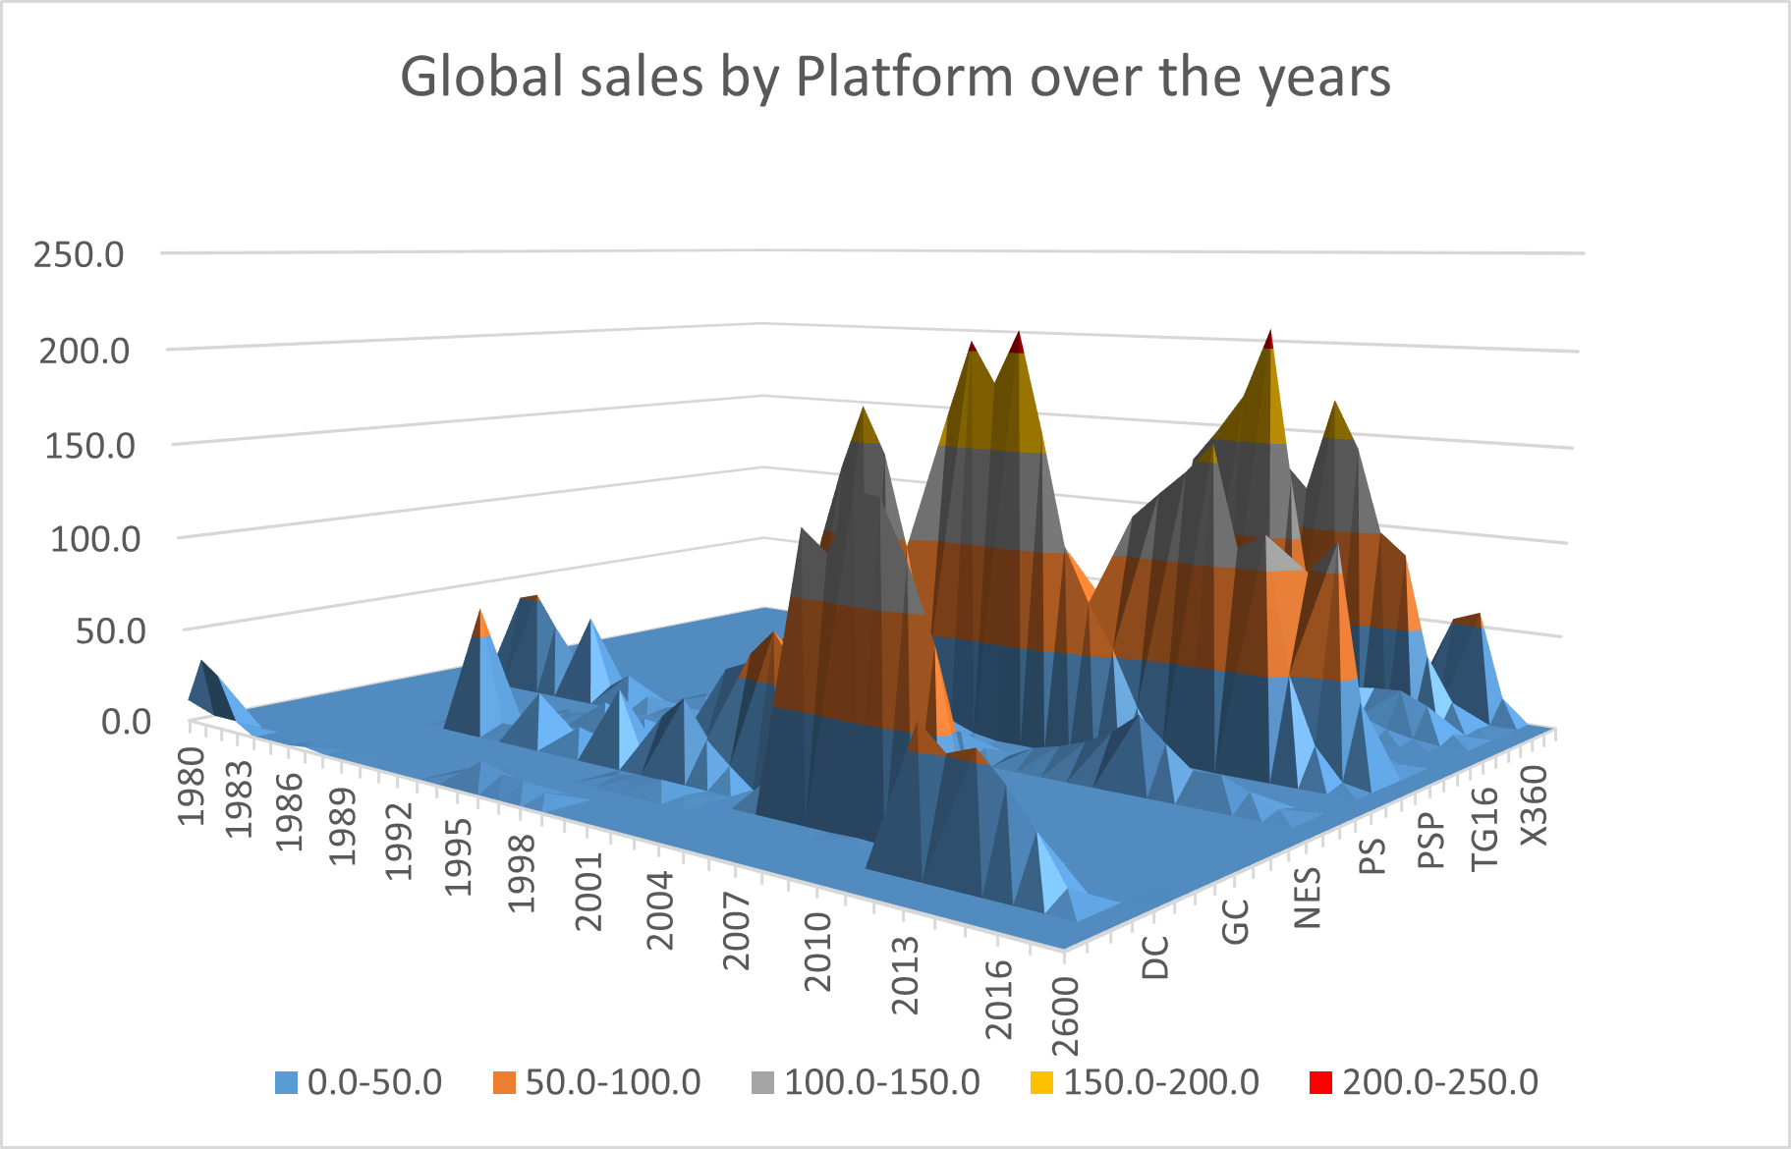
Video 1: Platform changing in two periods
Do customers return?
In this part, we compare changes in Platform popularity (sales by platform) in two shot periods each of 3 years for all 3 regions (see Video 1).
The period 2011-2013 is shown in yellow. The period 2014 - 2016 is shown in blue.
The video shows the volume of sales is changed by all platforms and by each region in its way.
The alarming data of customer changing platforms might be typical for the global market in the gaming industry.
But according to the dataset, the life cycle of a platform seems to be about 10 years (see figure 10.2). However, it is necessary to conduct additional research on customer loyalty to evaluate customer care and the customer support we provide.
Customer loyalty research is due to conduct.
Figure 10.2: Platform life cycle

Slide 13
Conclusions:
The sales volume of NA, EU, and JP regions decrease since 2009 by more than 50%.
The sales volume in 2016 continues to decrease exponentially. The sales volume in October 2016 is only 27% of the previous year’s sales volume.
Recommendations for marketing support by region:
The NA region needs Marketing support for Role-Playing game sales (actually 46% of the previous year’s sales).
The EU region needs stronger support for Role-Playing game sales and for Action games sales (actually 35% and 74 % of the previous year’s sales)
The JP region needs stronger marketing and management support for Role-playing game sales (in 2015 the sales decreased by 44%) and Fighting games (actually 39% from the previous year).
The Other regions need support for Role-Playing game sales (actually 60% from the previous year) and for Music genre games (the second year decreased by 57%). The revision of the sales strategy is recommended.
All regions need a strong Assortment revision
Recommendations for further analysis:
To conduct customer loyalty research to understand better business dynamics.

Slide 14
Thank you for your attention!

